Slide 1

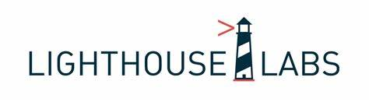
CYBER SECURITy
Advanced Lecture
Ryan Ternier

Slide 2

Agenda
INTRODUCTION
WHAT IS CYBER SECURITY
OWASP
SQL INJECTION
CODING EXAMPLES
QUESTIONS

Slide 3

INTRODUCTION
RYAN TERNIER
15 years managing, coaching, and cultivating high performing technology teams
20+ years experience as an Enterprise Solution architect & Full Stack Developer
ryan@konfluxus.com
https://www.linkedin.com/in/ryanternier/
Notes:
My name is Ryan Ternier, I’ve been managing, coaching, and cultivating high performing teams for over 15 years, and have been a enterprise solution architect and full stack developer for over 20 years.
For the past 7 years I have worked as the Director of Technology for a FinTech firm in Vancouver BC, focusing on delivering fund management systems and private equity trading platforms.

Slide 4
Cyber Security
Cyber Security is the practice of protecting systems, networks, and programs from digital attacks.
Cyber security is critical in our increasingly digital world, affecting everything from personal data to global infrastructure.
Notes:
Expand on the need for cybersecurity in various fields like banking, healthcare, and government. Explain that without robust cybersecurity, sensitive data can be stolen, and systems can be disrupted.

Slide 5
Cyber Security at 100,000 feet
Cybersecurity is the practice of protecting critical systems and sensitive information from digital attacks.
There are many types of cyber attacks, including phishing, malware, ransomware, denial of service attacks, and SQL injection.
Cyber attacks can result in data theft, financial loss, reputational damage, and even physical harm in some cases.
Notes:
Cybersecurity is the practice of protecting critical systems and sensitive information from digital attacks.
There are many types of cyber attacks, including phishing, malware, ransomware, denial of service attacks, and of course the topic of this lecture - SQL injection.
Cyber attacks are costly for the firm, and can be devastating to the individuals involved. PI data, private messages, company secrets, bank records, everything can be at the fingertips of a sophisticated attacker if they manage to get into your system.
Cyber Security is no joke.

Slide 6
Key Concepts of Cyber Security
Confidentiality: Ensuring that data is accessible only to those authorized to view it.
Integrity: Guaranteeing that data is accurate and unchanged.
Availability: Ensuring systems are up and running when they're needed.
Non-Repudiation: Guaranteeing that a party in a transaction cannot deny that the transaction occurred.
Authentication and Authorization: Confirming identities and granting correct levels of access.
Notes:
Provide examples for each concept.
confidentiality could be preserving the privacy of patient records in a hospital.
Integrity could be making sure that bank transactions are recorded correctly.
Availability – Hospital systems going offline, hydro companies offline
Non-Repudiation – Buying something online, seeing money leave your account, but not having any record that it occurred.
Authtication vs Authorization -

Slide 7
Real World Examples
SQL injection
Heartland Payment Systems (2008): An SQL Injection attack compromised 130 million credit and debit card numbers, making it one of the largest breaches in history.
Sony Pictures (2011): An SQL Injection vulnerability was used in an attack that led to the leak of thousands of confidential documents, emails, and unreleased films.
Notes:
Real-life examples to illustrate the importance of cybersecurity.
Show how these attacks were executed, who was affected, and what the consequences were.
What does SQL injection do?

Slide 8
Real World Examples
Cross-Site Scripting (XSS)
Fortnite (2019) : XSS vulnerability was exposed that affected over 200 million users. Attackers used XSS and insecure SSO vulnerabilities to redirect users to a fake login page allowing them to steal virtual currency within the game.
Ebay (2016) : The websites used a URL parameter that redirected users to a different pages on the platform. The value of this parameter was not validated, allowing attackers to inject malicious code into the page.
Notes:
Real-life examples to illustrate the importance of cybersecurity.
Show how these attacks were executed, who was affected, and what the consequences were.
Here are different ways to trigger an XSS attack:
A user can trigger the execution automatically when they load the page or hover over certain page elements, including hyperlinks.
Attackers can carry out XSS directly, for example, in an email message containing a malicious link.
Certain XSS attacks don’t have a particular target. Rather the attacker exploits a vulnerability in a site or application targeting random victims.

Slide 9
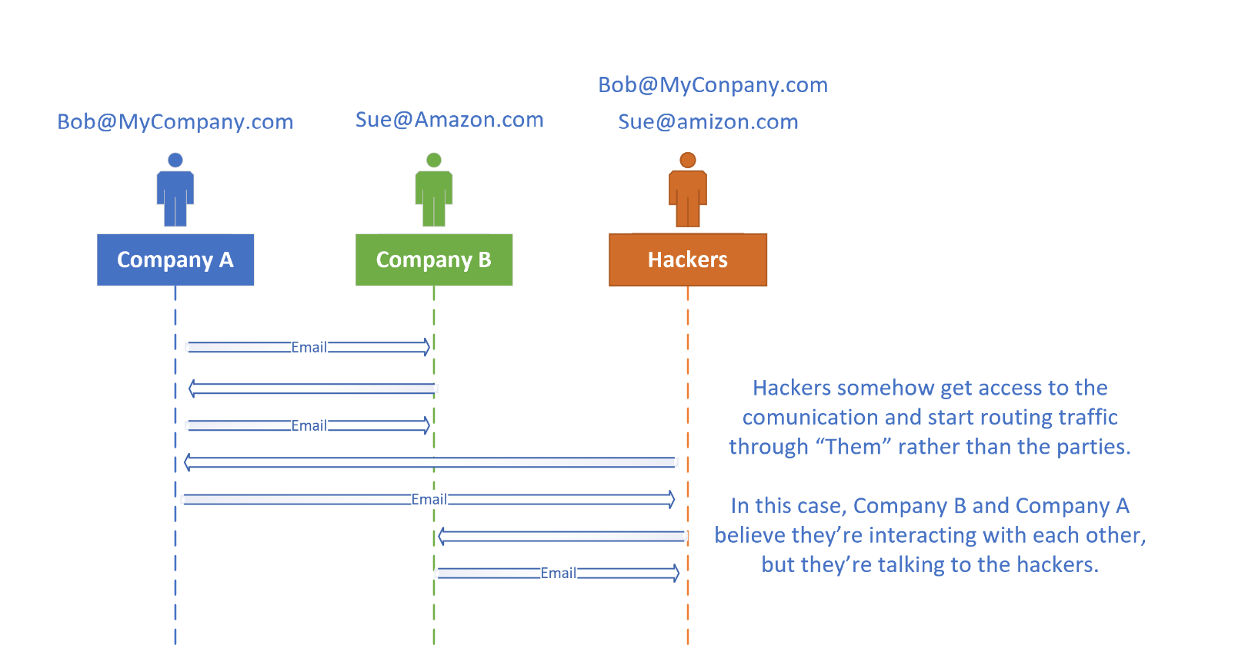
Man in the middle
Attack on Belgian Telecoms Company, Belgacom:
In 2013, the Belgian telecoms company Belgacom
suffered a high-profile
Man-in-the-Middle (MitM) attack
Personal Experience:
2022 – We were working on a $5million deal with a client. Their systems were compromised, and an attacker got hold of an email. They recreated all the Wire Transfer documents from both our banks and had multiple conversations with both parties. This was found when our lawyers and accountants double checked Wire instructions through a phone call.
Notes:
Man in the Middle
Email Hijacking
Wi-Fi Eavesdropping
DNS Spoofing
Session Hijacking
SSL Hijacking
ARP Cache Poisoning
Stealing Browser Cookies
Regardless of the specific techniques or stack of technologies needed to carry out a MITM attack, there is a basic work order:
Person A sends Person B a message.
The MITM attacker intercepts the message without Person A's or Person B's knowledge.
The MITM attacker changes the message content or removes the message altogether, again, without Person A's or Person B's knowledge.
Example at InvesTX.
How to prevent: Only connect to secure websites: This means look for a tiny padlock icon all the way to the left of the website URL in the browser's address bar. It is a sign that the webpage you are visiting is secure and using the HTTPS protocol. For security, employees—and web users overall—should never connect to regular HTTP sites or ones that do not have the padlock icon visible. To ensure this, users can consider installing a free browser plugin that can enforce this rule. Further, most comprehensive cybersecurity platforms include web filtering protocols that restrict employees from accessing non-HTTPS sites. Fortinet provides this with its FortiGuard Web Filtering service.
Encrypt DNS traffic: The DNS is the internet's distributed directory service. Applications use DNS to resolve a domain name to an IP address. However, when the DNS wants to connect to the external recursive DNS resolver, privacy and security become an issue because the DNS is distributed and no single security protocol exists. The handful of mechanisms that have emerged, including DNS over TLS (DoT) and DNS queries over HTTPS, encrypt DNS traffic between the user's computer and the external DNS resolver to validate the resolver's authenticity using certificates to ensure that no other party can impersonate the resolver.
Adopt the zero-trust philosophy: Zero trust is a security concept that requires organizations to not automatically trust anything inside or outside its perimeters. Instead, they must first verify anything trying to connect to their systems before granting access. The model is "never trust, always verify," and it relies on continuous verification across every device, user, and application. Zero-trust approaches can prevent a MITM attack from starting or can protect an organization's assets if a MITM attack is already underway.
Deploy a UEBA solution: User and entity behavior analytics (UEBA) uses machine learning to detect even the tiniest of anomalies in the behavior of both users and devices connected to the corporate network. As cyberattacks become more complex and as threat vectors can appear anywhere, machine learning tools are increasingly used to monitor small changes in behavior that might be suspicious and indicative of a MITM attack. The Fortinet UEBA solution, FortiInsight, not only continuously monitors the behavior of all users and endpoints but also employs automation to respond to threats in real time.
Use strong passwords and a password manager: Because passwords are not going away anytime soon, encourage employees to use strong passwords and a password manager. For company-owned devices, IT staff can install mobile device management software that features a password policy with rules pertaining to password length, complexity (i.e., use of special characters), aging, history/reuse, and the maximum number of password attempts before the device is remotely wiped.
If available, deploy multi-factor authentication (MFA): So you do not rely on passwords alone, organizations should encourage the use of MFA for access to devices and online services. This practice has quickly become organizations' best defense against threats.

Slide 10

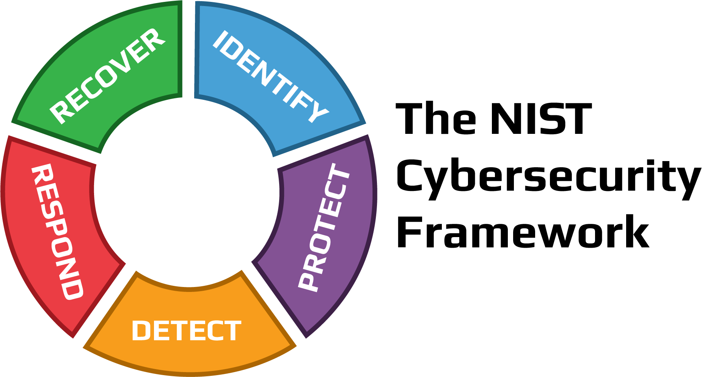
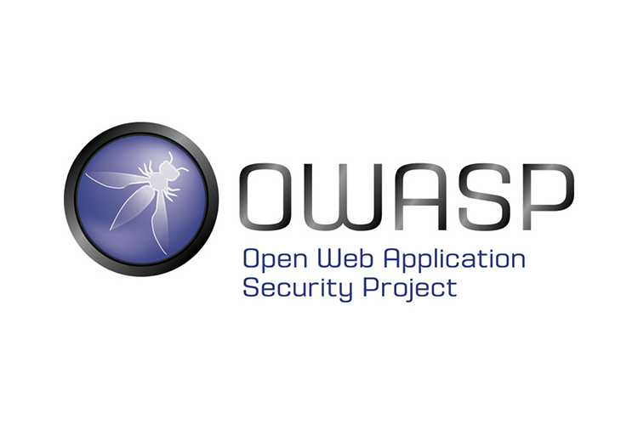
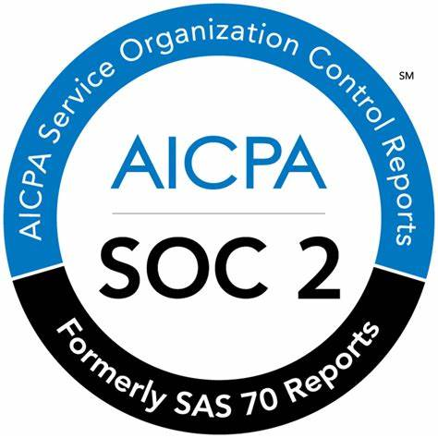
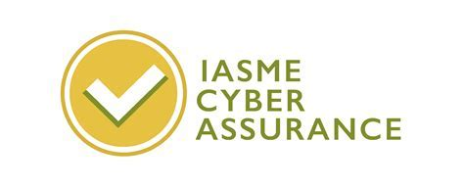
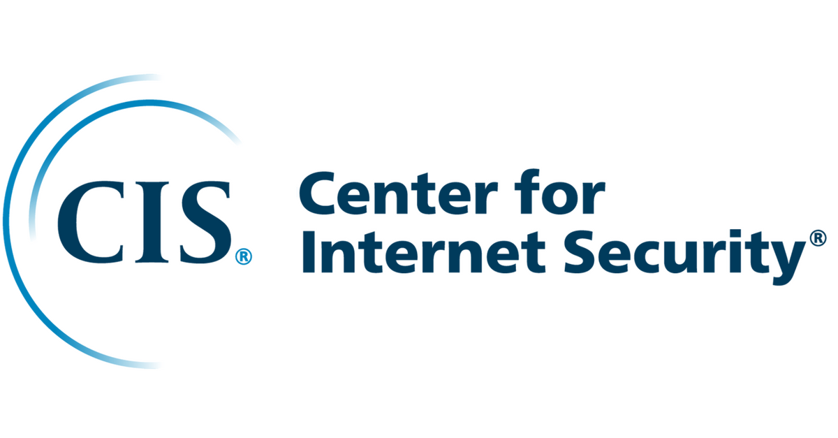


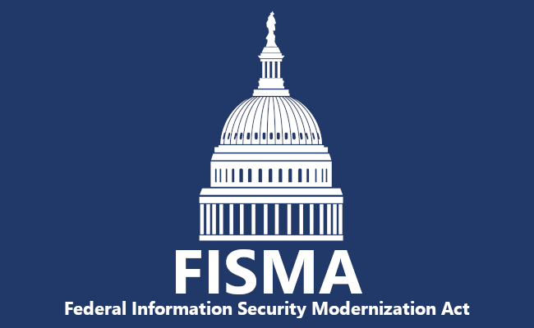
Cyber security
There are dozens of frameworks which define structures containing processes, practices, and technologies which companies use to secure networks, and computer systems from threats.

Slide 11


Notes:
Alright that was a bit heavy, let’s cheese it up.
As developers, you have the power to create software that can change the world for the better. However, with that power comes the responsibility to ensure that the software you create is secure and doesn't put users, their data, or your company, at risk of cyber attacks. By taking cyber security seriously and implementing best practices to protect against vulnerabilities, you can help create a safer, more secure digital world for everyone. Embrace your responsibility as a developer and make cyber security a priority in all of your projects.

Slide 12
OWASP
Open Web Application Security Project

Slide 13
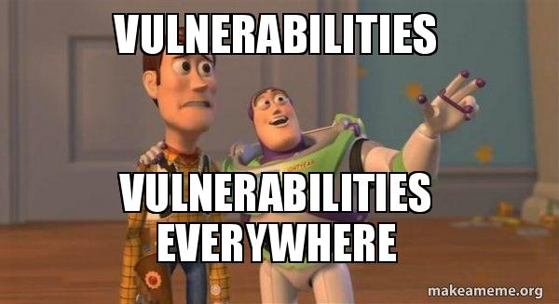
What is OWASP?
Notes:
Quick Slide – go through each point, focus on Injection.

Slide 14
OWASP
The Open Web Application Security Project (OWASP) is a non-profit organization dedicated to improving software security by providing tools, resources, and best practices for identifying and addressing vulnerabilities in web applications.
Notes:
he Open Web Application Security Project (OWASP) is a popular non-profit community that provides guidance and tools to help organizations build and maintain secure web applications. Every three to four years, OWASP releases a document titled the OWASP Top 10, in which they detail the ten most critical risks associated with web application security.
The OWASP Top 10 is primarily an awareness document. However, this has not stopped organizations using it as a de facto industry AppSec standard since its inception in 2003. The OWASP top 10 is considered the bare minimum, and a starting point. As you move through web development and into your professional career, the fundamentals listed in the OWASP top 10 will be needed in your day to day and should serve as a foundation for you.
A few years back one of my clients audited the technology stack and code and one of the questions was if we use the OWASP top 10 as a standard. We were asked how often the development team was trained on the OWASP Top 10, and if we audit our codebase and infrastructure against the list. Luckily I made a habit to go through this list every year with my teams, and ensure that developers, QA, and IT Operations are able to verify that our software is on-side in regard to this list. This is a very public list, and is well known in the Web Development world.

Slide 15
The OWASP Top 10 (2021)
Broken Access Control
Cryptographic Failures
Injection
Insecure Design
Security Misconfiguration
Vulnerable and Outdated Components
Identification and Authentication Failures
Software and Data Integrity Failures
Security Logging and Monitoring Failures
Server-Side Request Forgery
Notes:
this list is a resource for organizations to understand and prioritize their efforts towards securing their web applications.

Slide 16
XSS
Applications are vulnerable when…
Targeting website functions that accept user input—examples include login forms, search bars, and comment boxes. The attacker loads their malicious code on top of the valid website, deceiving the browser into running their malware whenever users load the site.
Malicious code on another domain—according to how the attacker injects the code, malicious content may not be on the actual website. It can be a transient element that only looks like part of the site at the time of exploitation.
Stealing session data—the JavaScript runs on the victim’s browser page, permitting the attacker to steal sensitive information about the user from the website session. The attacker can compromise the user’s session and gain unauthorized access.
Notes:
Cross-site scripting is when an attacker manipulates a vulnerable website so it returns malicious scripts to the user. This process typically involves JavaScript, but an attacker can use any client-side language. XSS primarily targets JavaScript due to the language’s integration with many browsers.

Slide 17
Broken Access Control
Ideally, web applications should make each piece of information available only to certain users according to their privileges. Broken access control can lead to critical security risks, allowing users to access the information they are not truly authorized to access.
Violation of the principle of least privilege or deny by default, where access should only be granted for particular capabilities, roles, or users, but is available to anyone.
Bypassing access control checks by modifying the URL (parameter tampering or force browsing), internal application state, or the HTML page, or by using an attack tool modifying API requests.
Permitting viewing or editing someone else's account, by providing its unique identifier (insecure direct object references)
Accessing API with missing access controls for POST, PUT and DELETE.
CORS misconfiguration allows API access from unauthorized/untrusted origins.
Notes:
How to prevent broken access control:
Set up and implement a secure development lifecycle that includes designing and evaluating security and privacy controls.
Set up and implement a library of secure design patterns.
Employ threat modeling for critical access control, authentication, key flows, and business logic.
Integrate security controls into user stories.
Add plausibility checks to each application tier, from front-end to back-end.
Depending on the required exposure and protection, segregate tier layers on the system and network layers.

Slide 18
Cryptographic Failures
The first thing is to determine the protection needs of data in transit and at rest.
For example, passwords, credit card numbers, health records, personal information, and business secrets require extra protection, mainly if that data falls under privacy laws, e.g., EU's General Data Protection Regulation (GDPR), or regulations, e.g., financial data protection such as PCI Data Security Standard (PCI DSS). For all such data:
Passwords
Government ID (SIN/SSN) numbers
Credit Card credentials
Banking Information
Notes:
Is any data transmitted in clear text? This concerns protocols such as HTTP, SMTP, FTP also using TLS upgrades like STARTTLS. External internet traffic is hazardous. Verify all internal traffic, e.g., between load balancers, web servers, or back-end systems.
Are any old or weak cryptographic algorithms or protocols used either by default or in older code?
Are default crypto keys in use, weak crypto keys generated or re-used, or is proper key management or rotation missing? Are crypto keys checked into source code repositories?
Is encryption not enforced, e.g., are any HTTP headers (browser) security directives or headers missing?
Is the received server certificate and the trust chain properly validated?
Are initialization vectors ignored, reused, or not generated sufficiently secure for the cryptographic mode of operation? Is an insecure mode of operation such as ECB in use? Is encryption used when authenticated encryption is more appropriate?
Are passwords being used as cryptographic keys in absence of a password base key derivation function?

Slide 19
SQL Injection
Applications are vulnerable when…
User Data is not validated, filtered, or sanitized
Dynamic Queries or non-parameterized calls without context-aware escaping are used directly.
Hostile data is used within object-relational mapping (ORM) search parameters
Hostile data is directly used or concatenated. The SQL or command contains the structure and malicious data in dynamic queries.
Injection as a whole is a very large subject; we’re focusing just on SQL Injection in this lecture.
Notes:
SQL injection is a type of attack that allows an attacker to execute malicious SQL statements to gain unauthorized access to a database or to manipulate data within a database.
SQL injection works by exploiting vulnerabilities in web applications that allow user input to be included in SQL queries without proper validation or sanitization.
There are several types of SQL injection attacks, including union-based SQL injection, error-based SQL injection, and blind SQL injection.
To prevent SQL injection, developers should use parameterized queries, validate and sanitize user input, escape special characters, and follow the least privilege principle.
Parameterized queries: Parameterized queries allow developers to separate user input from SQL code, which makes it more difficult for attackers to inject malicious SQL code.
Input validation and sanitization: Input validation and sanitization involves checking user input for validity and removing any potentially malicious input.
Least privilege principle: The least privilege principle involves giving users and applications the minimum level of access necessary to perform their tasks, which can help prevent SQL injection attacks.
Cyber attackers often use automation and bots to find SQL injection flaws in web applications. These automated tools can scan thousands of web pages in a short amount of time, searching for vulnerabilities that can be exploited. They can also be used to perform automated attacks on vulnerable applications, which can be especially dangerous if the application contains sensitive data or is part of a critical infrastructure. Most attackers do not sit at a keyboard and test your application, it is all scripted. However, once an experienced attacker finds a vulnerability, they will augment their attack with manual efforts to further exploit the system.

Slide 20
insecure design
Applications are vulnerable when…
Insecure design encompasses various risks that arise from ignoring design and architectural best practices, starting from the planning phase before actual implementation.
A quick point to note here is that an insecure design differs from an insecure implementation, and a near-perfect implementation cannot prevent defects arising from an insecure design. While the Insecure design flaw is a new entrant to the OWASP top 10, it ranks number four on the 2021 list since mitigating risks at the design phase is considered fundamental toward ‘Shift Left’ security practices.
Notes:
What are these vulnerabilities? This is a “vague” top 10.
Unprotected storage of Credentials
Trust boundary violations
Sending data through HTTP vs HTTPS, trusting unsecure data
Error message that include sensitive information
. There was a security issue where the default error page in ASP.NET applications would disclose the ASP.NET_SessionId cookie in the URL upon an error. This error page's behavior opened a possibility for Session Sidejacking. If an attacker could get this sessionID (for example, via a man-in-the-middle attack or from shared computer usage), they could potentially hijack the user's session and impersonate them.
Ways to Prevent it?
Secure Design using proper pattersn
Establish Secure Development Lifecycle with AppSec professionals
Segregateion

Slide 21
Security misconfiguration
The application might be vulnerable if the application is:
Missing appropriate security hardening across any part of the application stack or improperly configured permissions on cloud services.
Unnecessary features are enabled or installed (e.g., unnecessary ports, services, pages, accounts, or privileges).
Default accounts and their passwords are still enabled and unchanged.
Error handling reveals stack traces or other overly informative error messages to users.
For upgraded systems, the latest security features are disabled or not configured securely.
Secure settings in the application server / frameworks (Struts, Spring, .NET etc.).
No Security Headers
Notes:
Scenario #1: The application server comes with sample applications not removed from the production server. These sample applications have known security flaws attackers use to compromise the server. Suppose one of these applications is the admin console, and default accounts weren't changed. In that case, the attacker logs in with default passwords and takes over.
Scenario #2: Directory listing is not disabled on the server. An attacker discovers they can simply list directories. The attacker finds and downloads the compiled Java classes, which they decompile and reverse engineer to view the code. The attacker then finds a severe access control flaw in the application.

Slide 22
Vulnerable and outdated components
You are likely vulnerable:
If you do not know the versions of all components you use (both client-side and server-side). This includes components you directly use as well as nested dependencies.
If the software is vulnerable, unsupported, or out of date. This includes the OS, web/application server, database management system (DBMS), applications, APIs and all components, runtime environments, and libraries.
If you do not scan for vulnerabilities regularly and subscribe to security bulletins related to the components you use.
If you do not fix or upgrade the underlying platform, frameworks, and dependencies in a risk-based, timely fashion. This commonly happens in environments when patching is a monthly or quarterly task under change control, leaving organizations open to days or months of unnecessary exposure to fixed vulnerabilities.
Notes:
Remove unused dependencies, unnecessary features, components, files, and documentation.
Continuously inventory the versions of both client-side and server-side components (e.g., frameworks, libraries) and their dependencies using tools like versions, OWASP Dependency Check, retire.js, etc. Continuously monitor sources like Common Vulnerability and Exposures (CVE) and National Vulnerability Database (NVD) for vulnerabilities in the components. Use software composition analysis tools to automate the process. Subscribe to email alerts for security vulnerabilities related to components you use.
Only obtain components from official sources over secure links. Prefer signed packages to reduce the chance of including a modified, malicious component (See A08:2021-Software and Data Integrity Failures).

Slide 23
Identification and authentication failures
Confirmation of the user's identity, authentication, and session management is critical to protect against authentication-related attacks.
There may be authentication weaknesses if the application:
Permits automated attacks such as credential stuffing, where the attacker has a list of valid usernames and passwords.
Permits brute force or other automated attacks.
Permits default, weak, or well-known passwords, such as "Password1" or "admin/admin".
Uses weak or ineffective credential recovery and forgot-password processes, such as "knowledge-based answers," which cannot be made safe.
Uses Plain Text for PI / Secure Items
Notes:
Where possible, implement multi-factor authentication to prevent automated credential stuffing, brute force, and stolen credential reuse attacks.
Do not ship or deploy with any default credentials, particularly for admin users.
Implement weak password checks, such as testing new or changed passwords against the top 10,000 worst passwords list.
Align password length, complexity, and rotation policies with National Institute of Standards and Technology (NIST) 800-63b's guidelines in section 5.1.1 for Memorized Secrets or other modern, evidence-based password policies.
Ensure registration, credential recovery, and API pathways are hardened against account enumeration attacks by using the same messages for all outcomes.
Limit or increasingly delay failed login attempts, but be careful not to create a denial of service scenario. Log all failures and alert administrators when credential stuffing, brute force, or other attacks are detected.
Use a server-side, secure, built-in session manager that generates a new random session ID with high entropy after login. Session identifier should not be in the URL, be securely stored, and invalidated after logout, idle, and absolute timeouts

Slide 24
Software and data integrity failures
Software and data integrity failures relate to code and infrastructure that does not protect against integrity violations. An example of this is where an application relies upon plugins, libraries, or modules from untrusted sources, repositories, and content delivery networks (CDNs).
An insecure CI/CD pipeline can introduce the potential for unauthorized access, malicious code, or system compromise. Lastly, many applications now include auto-update functionality, where updates are downloaded without sufficient integrity verification and applied to the previously trusted application.
Attackers could potentially upload their own updates to be distributed and run on all installations. Another example is where objects or data are encoded or serialized into a structure that an attacker can see and modify is vulnerable to insecure deserialization.
Notes:
How to Prevent
Use digital signatures or similar mechanisms to verify the software or data is from the expected source and has not been altered.
Ensure libraries and dependencies, such as npm or Maven, are consuming trusted repositories. If you have a higher risk profile, consider hosting an internal known-good repository that's vetted.
Ensure that a software supply chain security tool, such as OWASP Dependency Check or OWASP CycloneDX, is used to verify that components do not contain known vulnerabilities
Ensure that there is a review process for code and configuration changes to minimize the chance that malicious code or configuration could be introduced into your software pipeline.
Ensure that your CI/CD pipeline has proper segregation, configuration, and access control to ensure the integrity of the code flowing through the build and deploy processes.
Ensure that unsigned or unencrypted serialized data is not sent to untrusted clients without some form of integrity check or digital signature to detect tampering or replay of the serialized data
Scenario #3 Insecure Deserialization: A React application calls a set of Spring Boot microservices. Being functional programmers, they tried to ensure that their code is immutable. The solution they came up with is serializing the user state and passing it back and forth with each request. An attacker notices the "rO0" Java object signature (in base64) and uses the Java Serial Killer tool to gain remote code execution on the application server.

Slide 25
Security logging and monitoring failures
This category is to help detect, escalate, and respond to active breaches. Without logging and monitoring, breaches cannot be detected. Insufficient logging, detection, monitoring, and active response occurs any time:
Auditable events, such as logins, failed logins, and high-value transactions, are not logged.
Warnings and errors generate no, inadequate, or unclear log messages.
Logs of applications and APIs are not monitored for suspicious activity.
Logs are only stored locally.
Appropriate alerting thresholds and response escalation processes are not in place or effective.
Penetration testing and scans by dynamic application security testing (DAST) tools (such as OWASP ZAP) do not trigger alerts.
The application cannot detect, escalate, or alert for active attacks in real-time or near real-time.
Notes:
Ensure all login, access control, and server-side input validation failures can be logged with sufficient user context to identify suspicious or malicious accounts and held for enough time to allow delayed forensic analysis.
Ensure that logs are generated in a format that log management solutions can easily consume.
Ensure log data is encoded correctly to prevent injections or attacks on the logging or monitoring systems.
Ensure high-value transactions have an audit trail with integrity controls to prevent tampering or deletion, such as append-only database tables or similar.
DevSecOps teams should establish effective monitoring and alerting such that suspicious activities are detected and responded to quickly.
Establish or adopt an incident response and recovery plan, such as National Institute of Standards and Technology (NIST) 800-61r2 or later.
Scenario #1: A children's health plan provider's website operator couldn't detect a breach due to a lack of monitoring and logging. An external party informed the health plan provider that an attacker had accessed and modified thousands of sensitive health records of more than 3.5 million children. A post-incident review found that the website developers had not addressed significant vulnerabilities. As there was no logging or monitoring of the system, the data breach could have been in progress since 2013, a period of more than seven years.
Scnario #2 – My last company,

Slide 26
Server side request forgery
Applications are vulnerable when…
SSRF flaws occur whenever a web application is fetching a remote resource without validating the user-supplied URL. It allows an attacker to coerce the application to send a crafted request to an unexpected destination, even when protected by a firewall, VPN, or another type of network access control list (ACL).
As modern web applications provide end-users with convenient features, fetching a URL becomes a common scenario. As a result, the incidence of SSRF is increasing. Also, the severity of SSRF is becoming higher due to cloud services and the complexity of architectures.
Notes:
Prevent From Application layer:
Sanitize and validate all client-supplied input data
Enforce the URL schema, port, and destination with a positive allow list
Do not send raw responses to clients
Disable HTTP redirections
Be aware of the URL consistency to avoid attacks such as DNS rebinding and “time of check, time of use” (TOCTOU) race conditions
Scenario #1: Port scan internal servers – If the network architecture is unsegmented, attackers can map out internal networks and determine if ports are open or closed on internal servers from connection results or elapsed time to connect or reject SSRF payload connections.
Scenario #2: Sensitive data exposure – Attackers can access local files or internal services to gain sensitive information such as file:///etc/passwd and http://localhost:28017/.
Scenario #3: Access metadata storage of cloud services – Most cloud providers have metadata storage such as http://169.254.169.254/. An attacker can read the metadata to gain sensitive information.

Slide 27

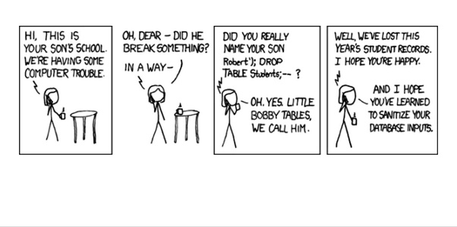
Example Time
Notes:
Let’s jump into some examples. We’re going to load up an API I’ve written in .NET 7. Now we can interact with this multiple ways: Swagger, or a sample web page. We’re going to use Swagger and a sample web app.
In the demo, We will look at a web application that is vulnerable to SQL injection by allowing user input to be included in SQL queries without proper validation or sanitization.
Next we will review how the injection attack will be executed on the remote server.
Finally, we’ll look at how to secure the application against these attacks by using: Parameters, Input validation, and other best practices

Slide 28

In Closing
Cyber Security Is a very large subject.
You are not in this alone.
As a web developer the OWASP top 10 is a very important subject
You’re not expected to be an expert, but you will.
Make sure to take the time and think of security in your solution and architecture.
Notes:
Cyber security is a very large subject, and it doesn’t just involve web development. Everything from server infrastructure, VPN control, physical and virtual firewalls, software design, and people can be vulnerable to an attack. Luckily, we have frameworks like the OWASP top 10 that give guidance to developers on how to best protect their web applications, and there is a whole community out there that is there to help you when it comes to implementing these practices.
This presentation was a starting point for learning and preventing SQL injection, but please don’t let this be the end of our journey in learning about this type of attack.

Slide 29



Questions?
Ryan Ternier
555 123-4567
ryan@example.com
Links to sources from this talk will be sent out upon request

